Slide 1
Computer Organization
Micro Architecture Level
The Processor: Datapath and Control

Slide 2
Six
Level Computer
LEVEL 5
Problem Oriented Language Level
(High Language Level)
Translation(Compiler)
LEVEL 4
Assembly Language Level
Translation(Assembler)
LEVEL 3
Operating System Machine Level
Partial Interpretation
(Operating System)
LEVEL 2
Instruction Set Architecture Level
Interpretation (Microprogram) /
Direct Execution (Hardwired)
LEVEL 1
Micro Architecture Level
Hardware
LEVEL 0
Digital Logic Level

Slide 3
GOAL: Datapath and control unit
Design a computer architecture
  To support the defined ISA
  To fetch and execute each instruction
Study of
  Processor designs
    • Single cycle
    • Multiple cycle
    • Pipelined

Slide 4
GOAL: Datapath and control unit
Study of
  Datapath
    • Basic components
    • How a datapath is constructed?
    • How the speed of the CPU is determined?
  Control unit
    • Why do we need control unit?
    • How control unit relates instructions and datapath?
    • Control unit design

Slide 5
Instruction Set Architecture (ISA)
A programmable system uses
  A sequence of instructions to control its operation
A typical instruction specifies:
  Operation to be performed
  Operands to use
  Where to place the result
  Which instruction to execute next

Slide 6
Instruction Set Architecture (ISA) (cont.)
Instructions are stored in
  RAM or ROM as a program
The addresses for instructions in a computer are provided by
  A program counter (PC) that can
    Count up
    Load a new address based on an instruction and, optionally, status information

Slide 7
Instruction Set Architecture (ISA) (cont.)
Part of the Control Unit to execute an instruction
  The PC and associated control logic
Executing an instruction –
  Activating the necessary sequence of operations specified by the instruction
  Controlled by the control unit and performed,
    In the datapath
    In the control unit
    In external hardware such as memory or input/output

Slide 8
ISA: Instruction Format
A instruction consists of a bit vector
  The fields of an instruction are subvectors representing specific functions and having specific binary codes defined
  The format of an instruction defines the subvectors and their function
An ISA usually contains multiple formats

Slide 9
MIPS Instruction & instuction Formats
Simplified only for
  Arithmetic-logic instructions : add, sub, and, or, slt
  Memory-reference instructions : lw, sw
  Control-flow instructions : beq, j
6 bits
5 bits
5 bits
5 bits
5 bits
6 bits
op
rs
rt
rd
shamt
funct
R-Format
6 bits
5 bits
5 bits
16 bits
op
rs
rt
offset
I-Format
6 bits
26 bits
J-Format
op
address

Slide 10
Implementing MIPS: the Fetch/Execute Cycle
High-level abstract view of fetch/execute implementation
  use the program counter (PC) to read instruction address
  fetch the instruction from memory and increment PC
  use fields of the instruction to select registers to read
  execute depending on the instruction
  repeat…

Slide 11
Processor Implementation Styles
Single Cycle
  Perform each instruction in 1 clock cycle
  Clock cycle must be long enough for slowest instruction
Multi-Cycle
  Break fetch/execute cycle into multiple steps
  Perform 1 step in each clock cycle
Pipelined

Slide 12
Single Vs. Multi-Cycle Processor Machine
Cycle time = 20 ns
Cycle time = 5 ns
1 cycle
4 cycles
Load
Load
1 cycle
3 cycles
Add
Add
1 cycle
2 cycles
Beq
Beq
Time for a load, add, and beq = 60 ns 45 ns
In the Single cycle implementation, every instruction requires one cycle to complete, so cycle time = time taken for the slowest instruction
If the execution was broken into multiple (faster)
cycles, the shorter instructions can finish sooner

Slide 13
Processor Implementation Styles
Single Cycle
  Perform each instruction in 1 clock cycle
  Clock cycle must be long enough for slowest instruction
  Disadvantage: only as fast as the slowest instruction
Multi-Cycle
  Break fetch/execute cycle into multiple steps
  Perform 1 step in each clock cycle
  Advantage: each instruction uses only as many cycles as it needs
Pipelined
  Execute each instruction in multiple steps
  Perform 1 step / instruction in each clock cycle

Slide 14
Processor Implementation Styles
Unpipelined
Start and finish a job before moving to the next
Jobs
Time
A
B
C
A
B
C
Break the job into smaller stages
A
B
C
A
B
C
Pipelined

Slide 15
Processor Implementation Styles
Single Cycle
  Perform each instruction in 1 clock cycle
  Clock cycle must be long enough for slowest instruction
  Disadvantage: only as fast as the slowest instruction
Multi-Cycle
  Break fetch/execute cycle into multiple steps
  Perform 1 step in each clock cycle
  Advantage: each instruction uses only as many cycles as it needs
Pipelined
  Execute each instruction in multiple steps
  Perform 1 step / instruction in each clock cycle
  Process multiple instructions in parallel

Slide 16
Functional Elements
Two types of functional elements in the hardware:
  Elements that operate on data
    Called combinational elements
  Elements that contain data
    Called state or sequential elements

Slide 17

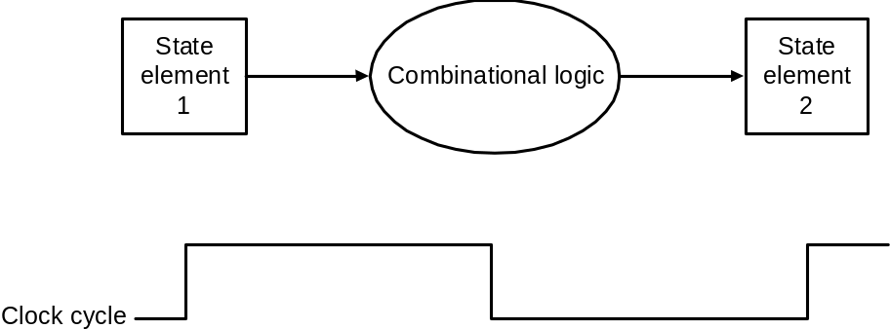
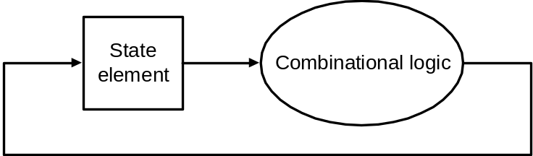
Combinational Elements
Works as an input ⇒ output function, e.g., ALU
Combinational logic reads input data from one register and writes output data to another, or same, register
  read/write happens in a single cycle – combinational element cannot store data from one cycle to a future one
Combinational logic hardware units
Notes:
Figure 2 shows the two state elements surrounding a block of combinational logic, which operates in a single clock cycle. All signal must propagate from state element 1 through the combinational logic, and to state element 2 in the time of one clock cycle. The time necessary for the signals to reach state element 2 defines the length of the clock cycle.

Slide 18
State Elements
Contain data in internal storage, e.g., registers and memory
All state elements together define the state of the machine
Flipflops and latches are 1-bit state elements, equivalently, they are 1-bit memories
The output(s) of a flipflop or latch always depends on the bit value stored, i.e., its state, and can be called 1/0 or high/low or true/false
The input to a flipflop or latch can change its state depending on whether it is clocked or not…

Slide 19
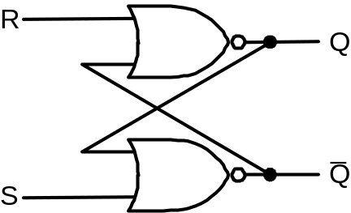
Set-Reset (SR-) latch
(unclocked)
Basic memory unit
Made from two cross-coupled nand gates
When both Sbar and Rbar are 1, then either one
of the following two states is stable:
Q = 1 & Qbar = 0
Q = 0 & Qbar = 1
and the latch will continue in the current stable
state.
If Sbar changes to 0 (while Rbar remains at 1),
then the latch is forced to the exactly one
possible stable state (a). If Rbar changes to 0
(while Sbar remains at 1), the latch is forced to
the exactly one possible stable state (b).
So, the latch remembers which of Sbar or Rbar
was last 0 during the time they are both 1.
When both Sbar and Rbar are 0 the exactly one
stable state is Q = Qbar = 1. However, if after
that both Sbar and Rbar return to 1, the latch must
then jump non-deterministically to one of stable
states (a) or (b), which is undesirable behavior.
Think of Sbar as S, the inverse of set (which
sets Q to 1), and Rbar as R, the inverse of reset.
Sbar(set)
n1
Q
Rbar
(reset)
n2
Qbar
equivalently with nor gates

Slide 20
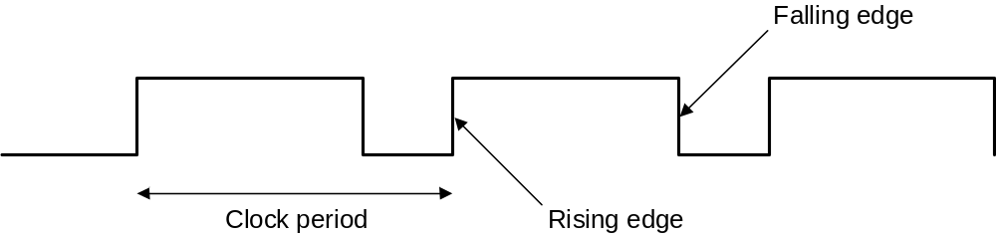
Synchronous Logic:
Clocked Latches and Flipflops
Clocks are used in synchronous logic to determine when a state element is to be updated
  in level-triggered clocking methodology either the state changes only when the clock is high or only when it is low (technology-dependent)
  in edge-triggered clocking methodology either the rising edge or falling edge is active (depending on technology) – i.e., states change only on rising edges or only on falling edge
Latches are level-triggered
Flipflops are edge-triggered

Slide 21
Clocked SR-latch
State can change only when clock is high
Potential problem : both inputs Sbar = 0 & Rbar = 0 will cause non-deterministic behavior
Sbar
X
r1
n1
Q
clk
a
clkbar
Rbar
r2
n2
Qbar
Y

Slide 22
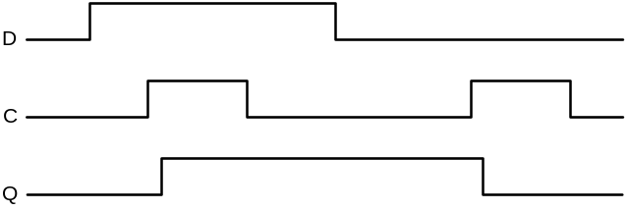
Clocked D-latch
State can change only when clock is high
Only single data input (compare SR-latch)
No problem with non-deterministic behavior
D
a2
Dbar
X
r1
n1
Q
clk
clkbar
a1
r2
n2
Qbar
Y
Timing diagram of D-latch

Slide 23
Clocked D-flipflop
Negative edge-triggered
Made from three SR-latches
sbar
clear
cbar
s
q
clkbar
clk
r
qbar
rbar
d

Slide 24
Logi Sim
All components that we have discussed – and shall discuss – can be fabricated using Logi Sim

Slide 25
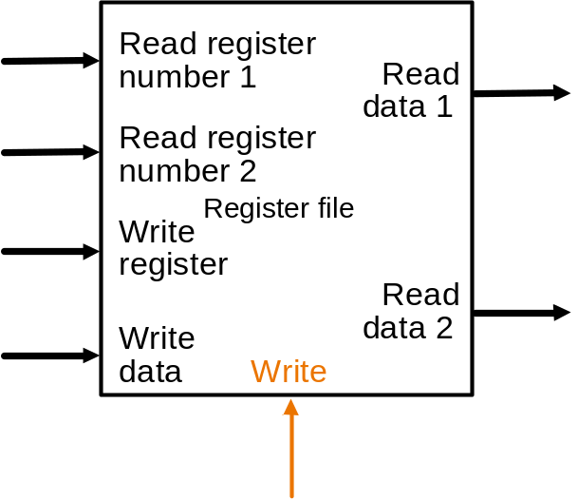
State Elements on the Datapath: Register File
Registers are implemented with arrays of D-flipflops
Clock
5 bits
32 bits
5 bits
5 bits
32 bits
32 bits
Control signal
Register file with two read ports and one write port

Slide 26
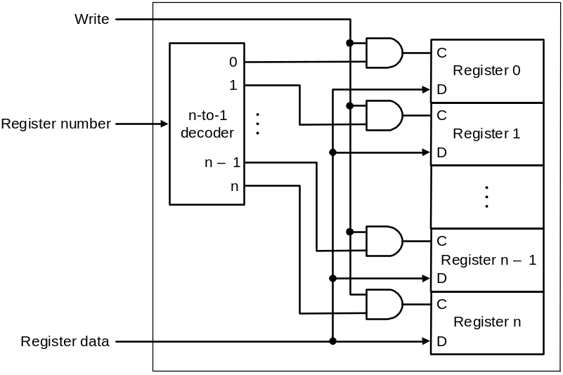
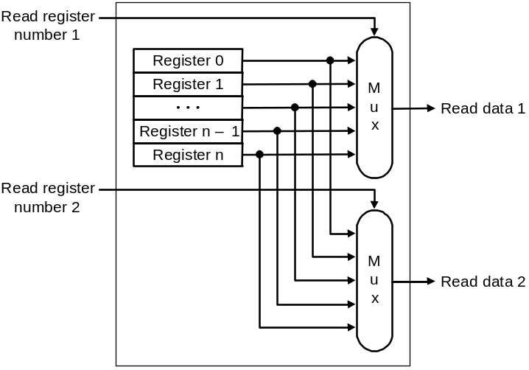
State Elements on the Datapath: Register File
Port implementation:
Clock
Clock
Read ports are implemented
with a pair of multiplexors – 5
bit multiplexors for 32 registers
Write port is implemented using
a decoder – 5-to-32 decoder for
32 registers. Clock is relevant to
write as register state may change
only at clock edge

Slide 27
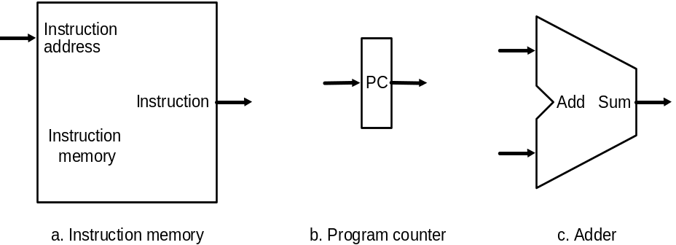
Datapath:
Instruction Store/Fetch & PC Increment
Three elements used to store and fetch instructions and increment the PC

Slide 28
Datapath:
Instruction Store/Fetch & PC Increment
Three elements used to store and fetch instructions and increment the PC

Slide 29
Datapath:
Instruction Store/Fetch & PC Increment
Three elements used to store and fetch instructions and increment the PC

Slide 30
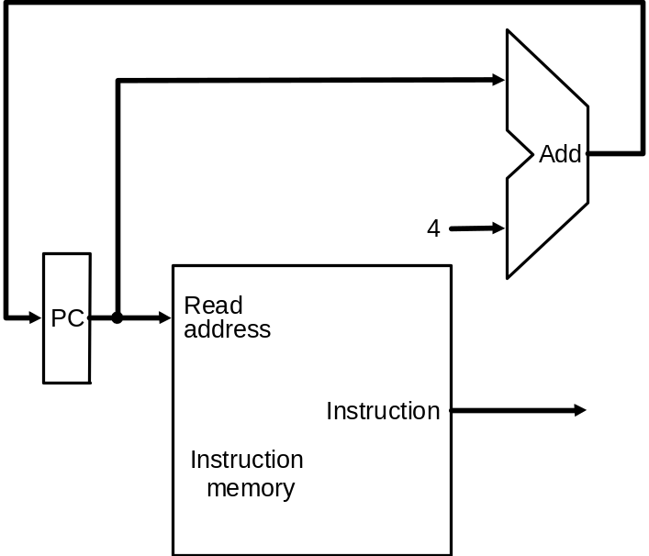
Datapath:
Instruction Store/Fetch & PC Increment
Three elements used to store and fetch instructions and increment the PC
Datapath

Slide 31
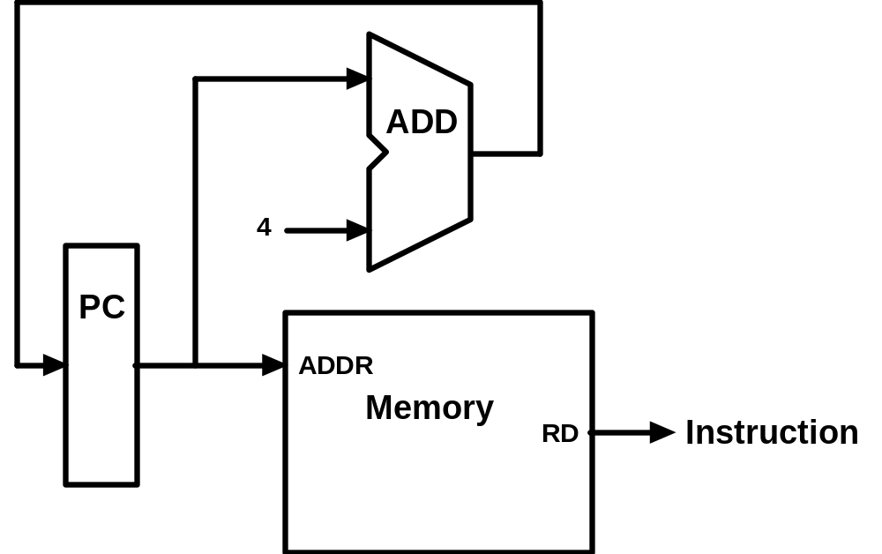
Animating the Datapath
Instruction <- MEM[PC]
PC <- PC + 4

Slide 32
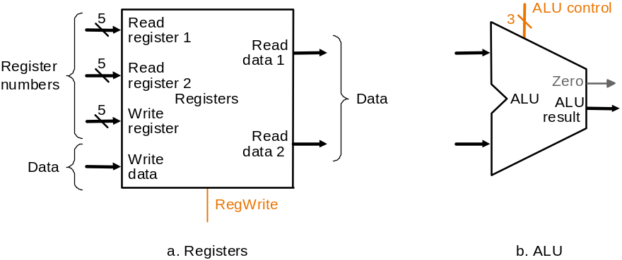
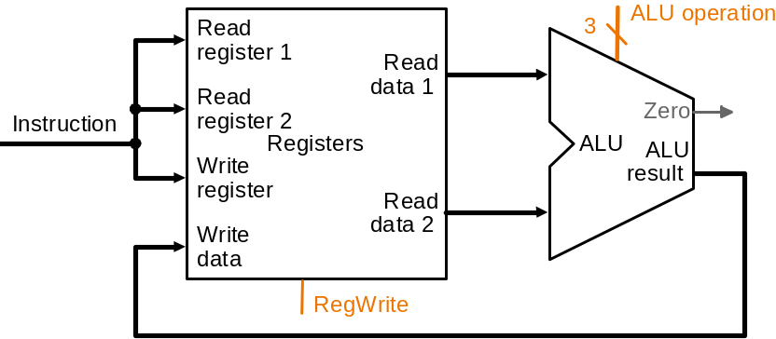
Datapath: R-Type Instruction
Two elements used to implement R-type instructions
Datapath

Slide 33
Datapath: R-Type Instruction
Two elements used to implement R-type instructions
Datapath

Slide 34
Datapath: R-Type Instruction
Two elements used to implement R-type instructions
Datapath

Slide 35
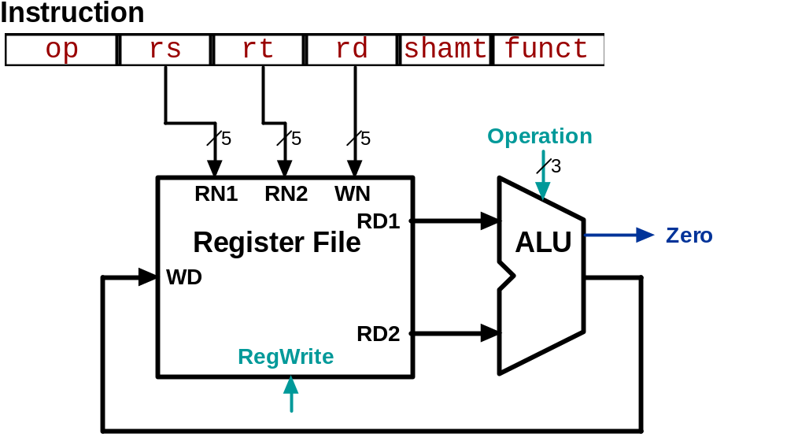
Animating the Datapath
add rd, rs, rt
R[rd] <- R[rs] + R[rt];
Notes:
WN : Write (Destination) Register Number
RN : Register No.
RD : Read Data
WD : Write Data

Slide 36
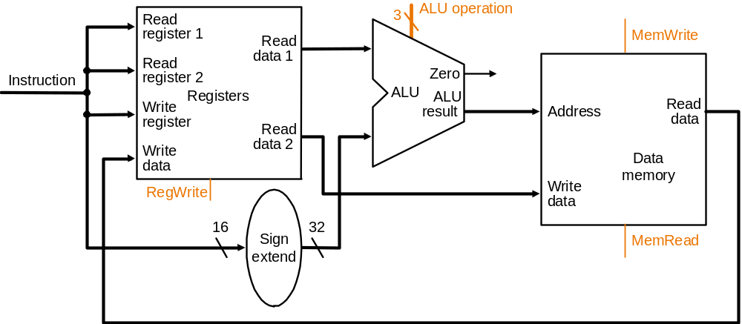
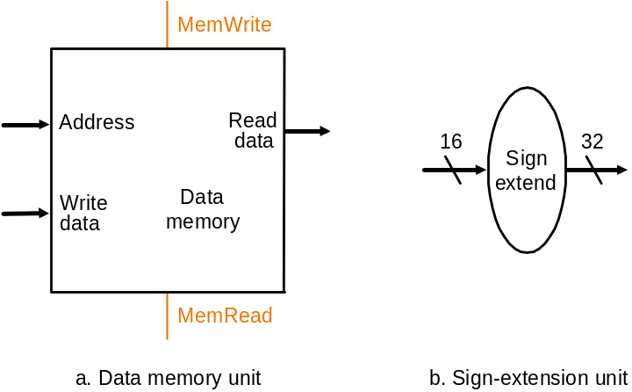
Datapath: Load/Store Instruction
Two additional elements used
To implement load/stores
Datapath

Slide 37
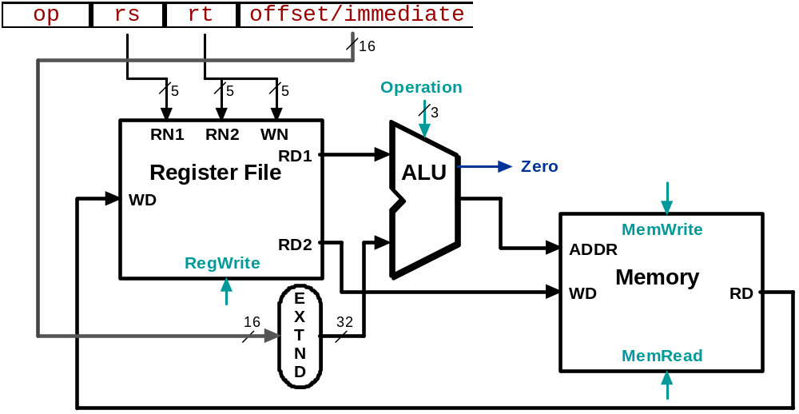
Animating the Datapath
lw rt, offset(rs)
R[rt] <- MEM[R[rs] + s_extend(offset)];
Notes:
WN : Write (Destination) Register Number
RN : Register No.
RD : Read Data
WD : Write Data

Slide 38
Animating the Datapath
sw rt, offset(rs)
MEM[R[rs] + sign_extend(offset)] <- R[rt]

Slide 39
Recall: Branch Addressing
Branch instructions:
    beq rs, rt, L1
    bne rs, rt, L1
  Specify:
    Opcode, two registers, target address
Format:
16 bit Address ?
op rs rt constant or address
6 bits 5 bits 5 bits 16 bits

Slide 40
Recall: Branch Addressing
16 bits is too small a reach in a 2³² address space
Solution:
  Principle of locality
    Most branch targets are near branch
    Forward or backward Direction
  Use PC (= program counter), called PC-relative addressing based on Principle of Locality
  PC-relative addressing
    Target address = PC + offset × 4
    PC already incremented by 4 by this time

Slide 41
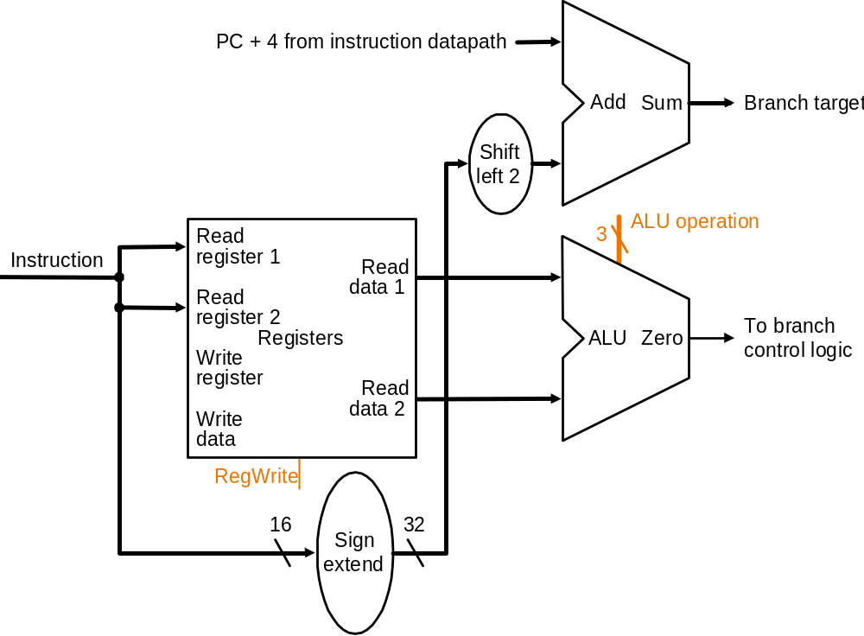
Datapath: Branch Instruction
How to?
No shift hardware required:
simply connect wires from
input to output, each shifted
left 2 bits
Datapath

Slide 42
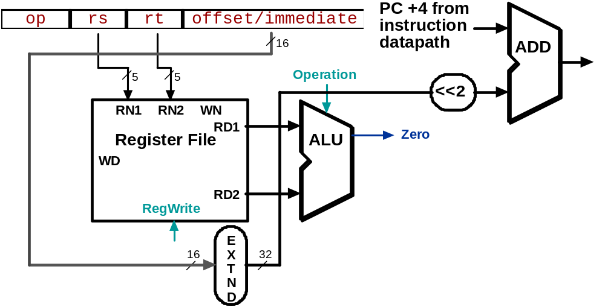
Animating the Datapath
beq rs, rt, offset
  if (R[rs] == R[rt]) then
  PC ← PC+4 + s_extend(offset<<2)

Slide 43
Composing of the Elements
Each datapath element can only do one function at a time
Check possibility
  Need separate instruction and data memories
  Use multiplexers where alternate data sources are used for different instructions

Slide 44
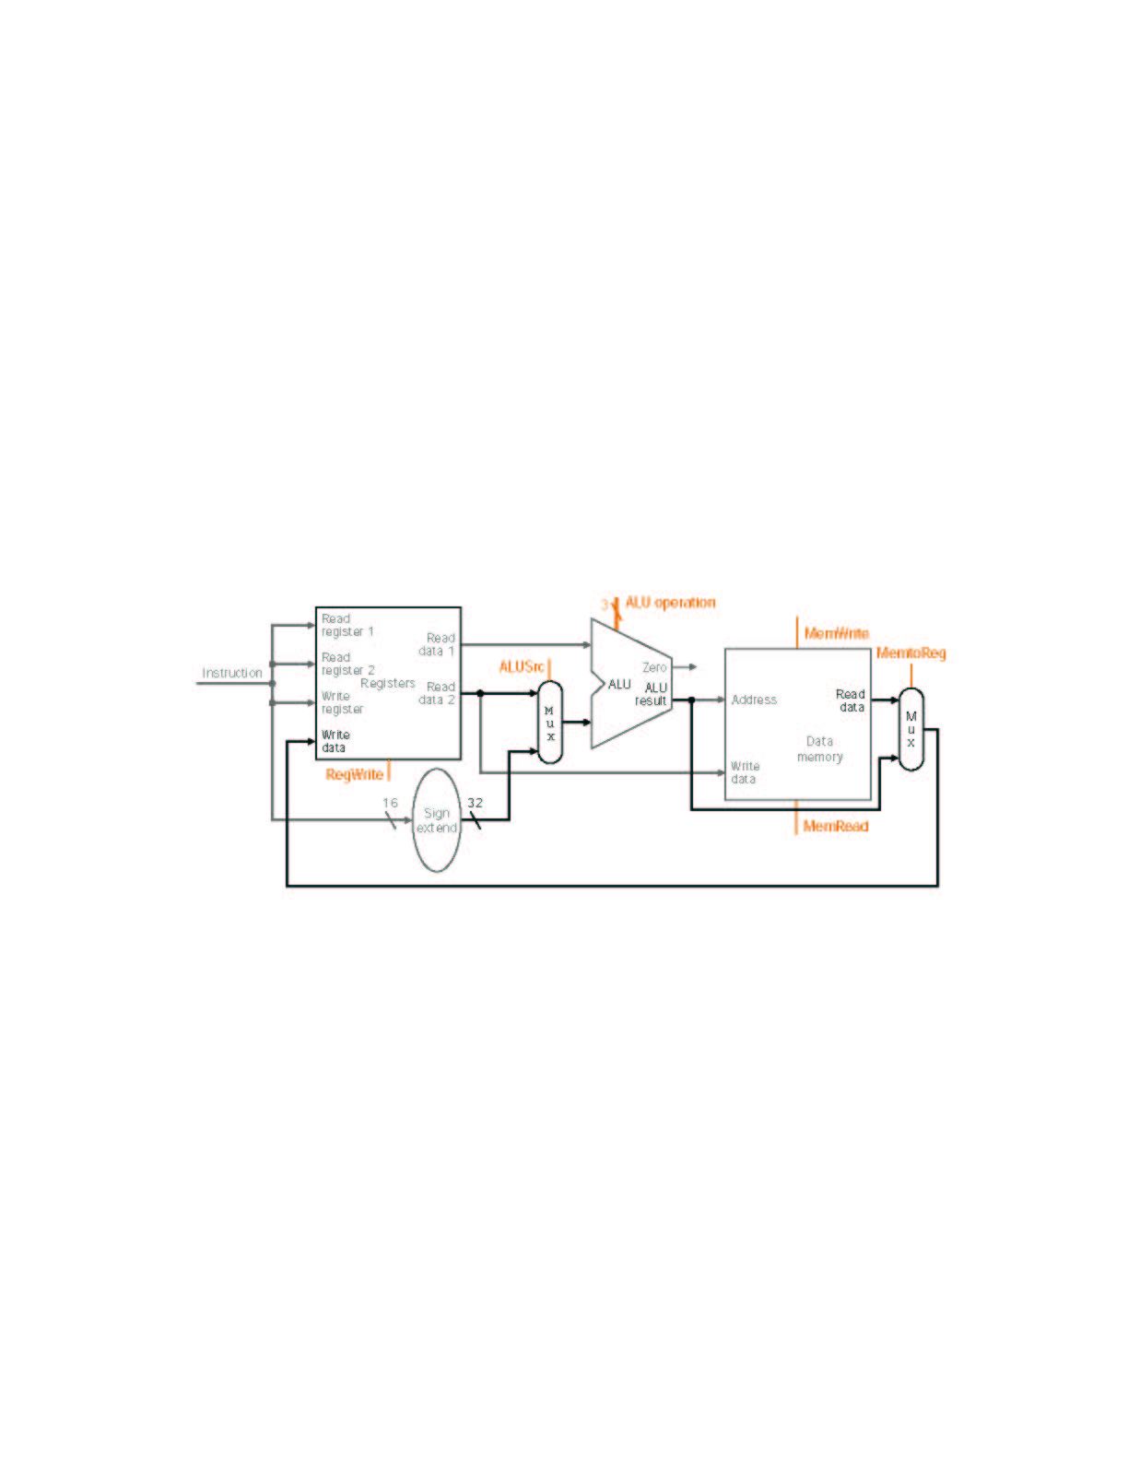
MIPS Datapath I: Single-Cycle
Input is either register (R-type) or sign-extended
lower half of instruction (load/store)
Data is either
from ALU (R-type)
or memory (load)
Combining the datapaths for R-type instructions
and load/stores using two multiplexors

Slide 45
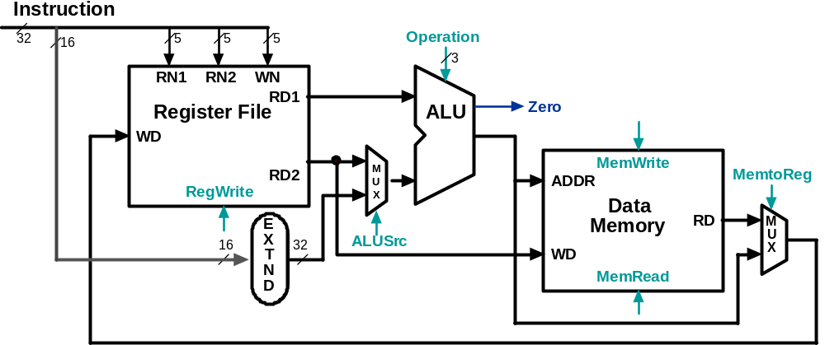
Animating the Datapath:
R-type Instruction
add rd,rs,rt

Slide 46
Animating the Datapath:
Load Instruction
lw rt,offset(rs)

Slide 47
Animating the Datapath:
Store Instruction
sw rt,offset(rs)

Slide 48
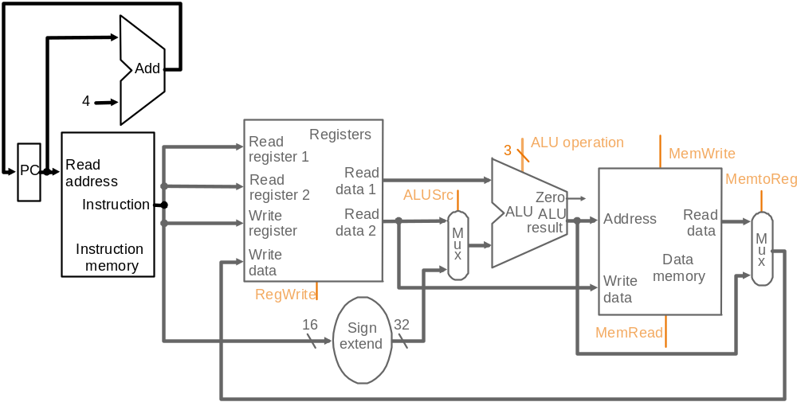
MIPS Datapath II: Single-Cycle
Separate adder as ALU operations and PC
increment occur in the same clock cycle
Separate instruction memory
as instruction and data read
occur in the same clock cycle
Adding instruction fetch

Slide 49
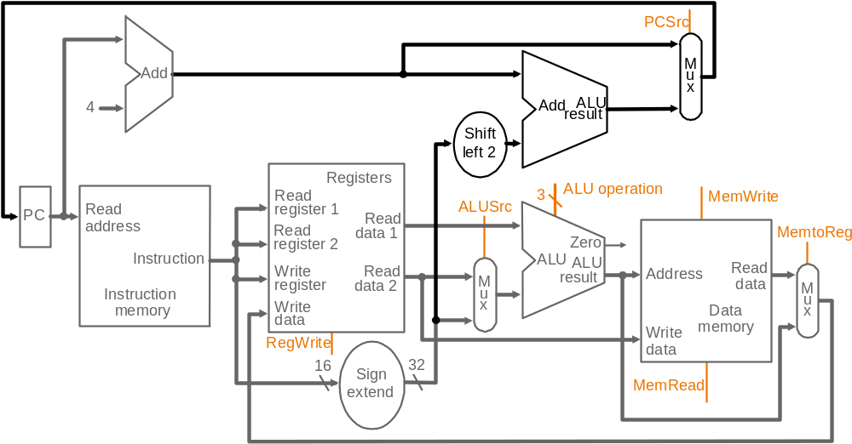
MIPS Datapath III: Single-Cycle
New multiplexor
Extra adder needed as both
adders operate in each cycle
Instruction address is either
PC+4 or branch target address
Adding branch capability and another multiplexor
Important note: in a single-cycle implementation data cannot be stored
during an instruction – it only moves through combinational logic

Slide 50
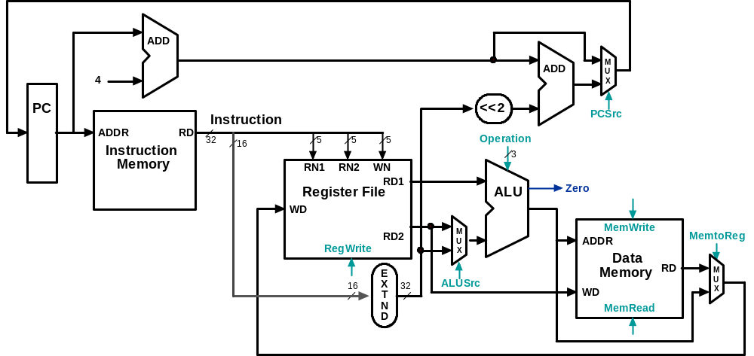
Datapath Executing add
add rd, rs, rt

Slide 51
Datapath Executing lw
lw rt,offset(rs)

Slide 52
Datapath Executing sw
sw rt,offset(rs)

Slide 53
Datapath Executing beq
beq r1,r2,offset

Slide 54
Control
Control unit takes input from
  The instruction opcode bits
Control unit generates
  Write enable (possibly, read enable also) signals for each storage element
  Selector controls for each multiplexor
  ALU control input

Slide 55
Designing the Main Control
R-type
opcode
rs
rt
rd
shamt
funct
31-26
25-21
20-16
15-11
10-6
5-0
Load/store
or branch
opcode
rs
rt
address
31-26
25-21
20-16
15-0
Observations about MIPS instruction format
  opcode is always in bits 31-26
  two registers to be read are always rs (bits 25-21) and rt (bits 20-16)
  base register for load/stores is always rs (bits 25-21)
  16-bit offset for branch equal and load/store is always bits 15-0
  destination register for loads is in bits 20-16 (rt) while for R-type instructions it is in bits 15-11 (rd) (will require multiplexor to select)

Slide 56
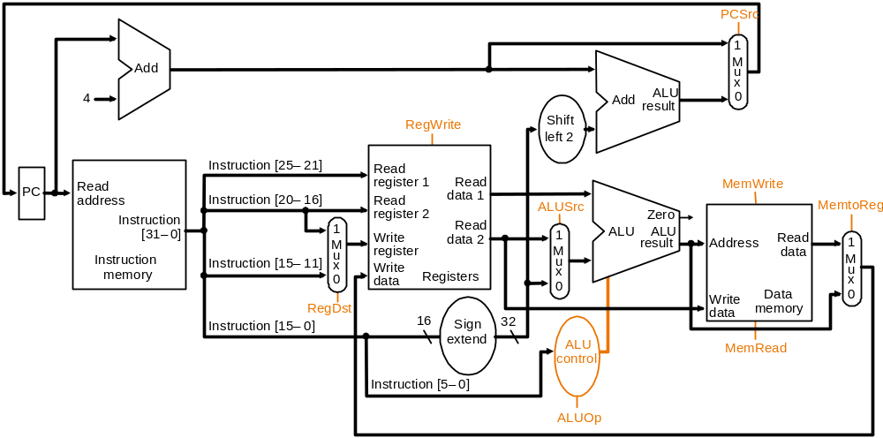
Datapath with Control I
New multiplexor
Adding control to the MIPS Datapath III (and a new multiplexor to select field to
specify destination register)

Slide 57
Control Signals
Signal Name Effect when deasserted Effect when asserted
RegDst The register destination number for the The register destination number for the
Write register comes from the rt field (bits 20-16) Write register comes from the rd field (bits 15-11)
RegWrite None The register on the Write register input is written
with the value on the Write data input
AlLUSrc The second ALU operand comes from the The second ALU operand is the sign-extended,
second register file output (Read data 2) lower 16 bits of the instruction
PCSrc The PC is replaced by the output of the adder The PC is replaced by the output of the adder
that computes the value of PC + 4 that computes the branch target
MemRead None Data memory contents designated by the address
input are put on the first Read data output
MemWrite None Data memory contents designated by the address
input are replaced by the value of the Write data input
MemtoReg The value fed to the register Write data input The value fed to the register Write data input
comes from the ALU comes from the data memory
Effects of the seven control signals

Slide 58
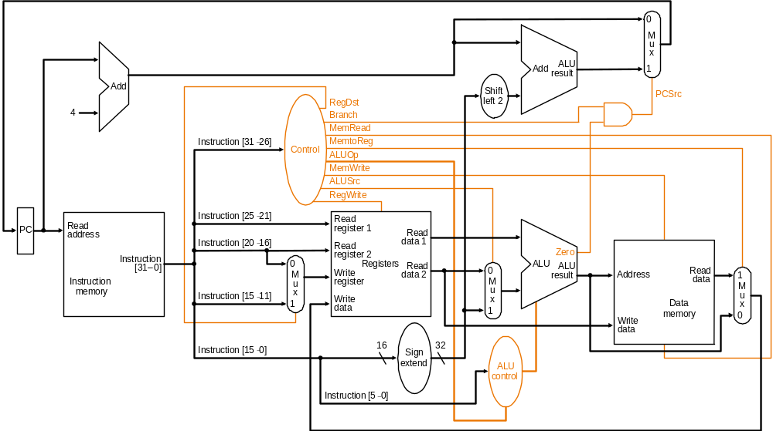
Datapath with Control II
MIPS datapath with the control unit: input to control is the 6-bit instruction
opcode field, output is seven 1-bit signals and the 2-bit ALUOp signal

Slide 59
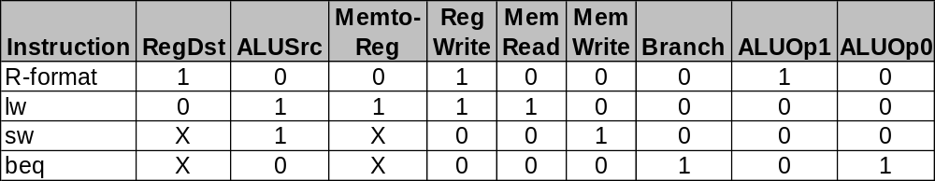
Datapath with
Control II (cont.)
PCSrc cannot be
set directly from the
opcode: zero test
outcome is required
Determining control signals for the MIPS datapath based on instruction opcode

Slide 60
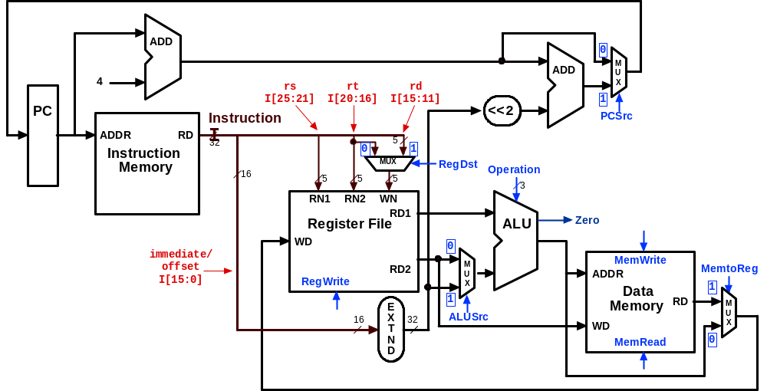
Control Signals:
R-Type Instruction
0
???
Value depends on funct
1
0
0
1
Control signals
shown in blue
0
0

Slide 61
Control Signals: lw Instruction
0
010
0
0
1
1
Control signals
shown in blue
1
1

Slide 62
Control Signals: sw Instruction
0
010
X
1
X
0
Control signals
shown in blue
1
0

Slide 63
Control Signals: beq Instruction
1 if Zero=1
110
X
0
X
0
Control signals
shown in blue
0
0

Slide 64
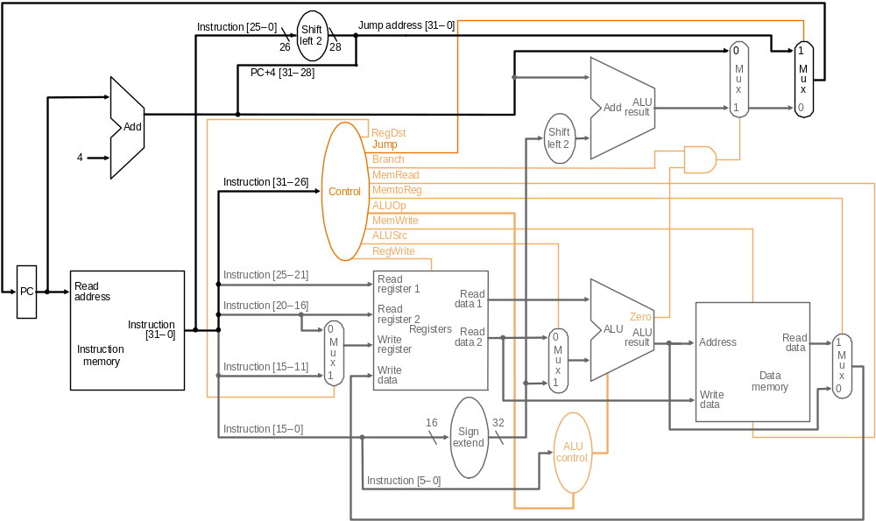
Datapath with Control III
Jump
opcode
address
31-26
Composing jump
target address
25-0
New multiplexor with additional
control bit Jump
MIPS datapath extended to jumps: control unit generates new Jump control bit

Slide 65
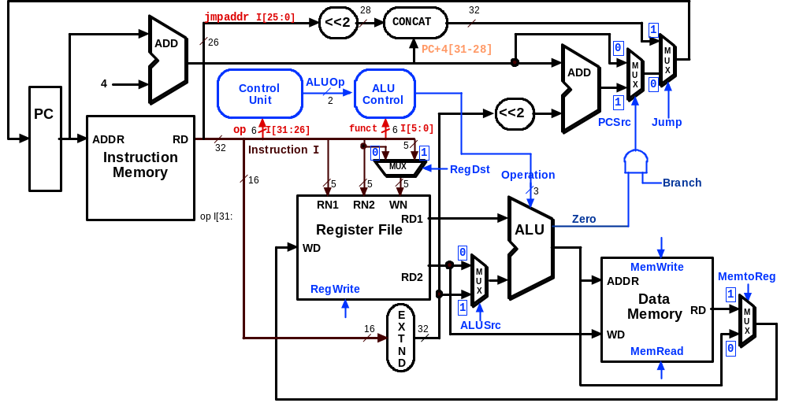
Datapath Executing j

Slide 66
R-Type Instruction Steps add $t1, $t2, $t3
Fetch instruction and increment PC
Read two source registers from the register file
ALU operates on the two register operands
Write result to register

Slide 67
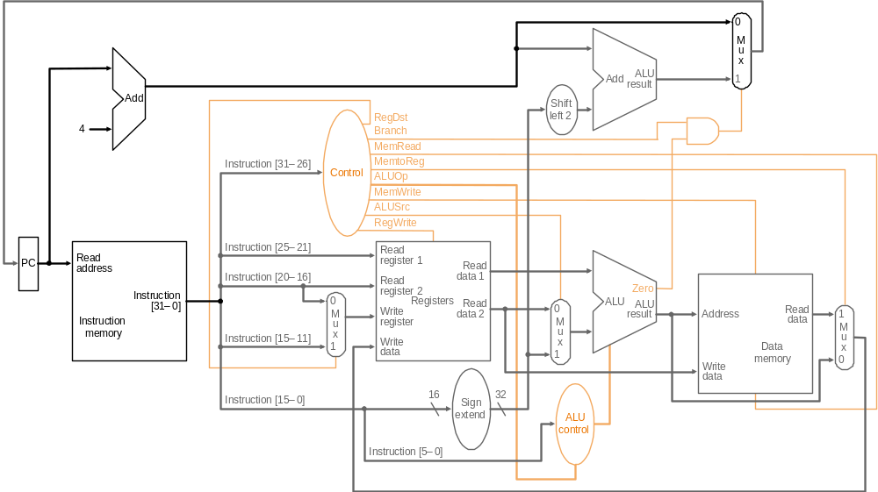
R-type Instruction: Step 1 add $t1, $t2, $t3 (active = bold)
Fetch instruction and increment PC count

Slide 68
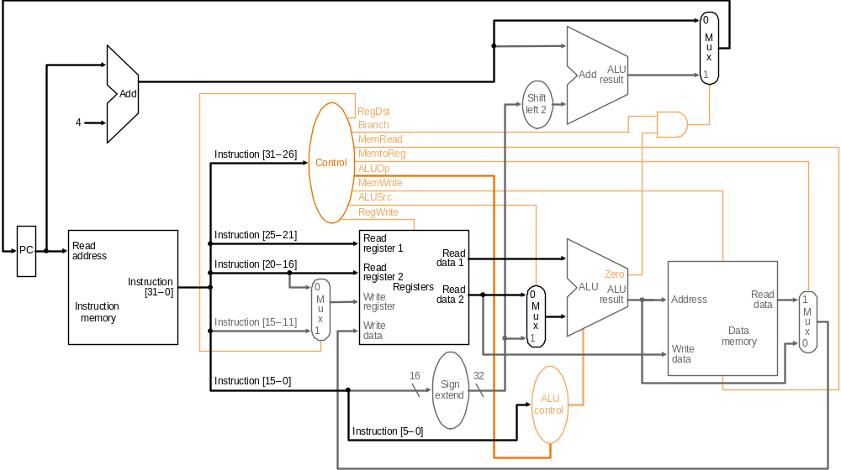
R-type Instruction: Step 2 add $t1, $t2, $t3 (active = bold)
Read two source registers from the register file

Slide 69
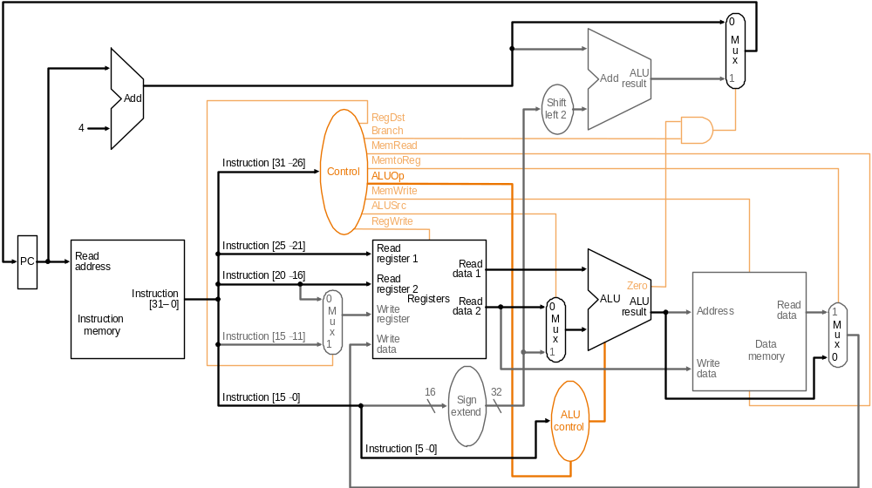
R-type Instruction: Step 3 add $t1, $t2, $t3 (active = bold)
ALU operates on the two register operands

Slide 70
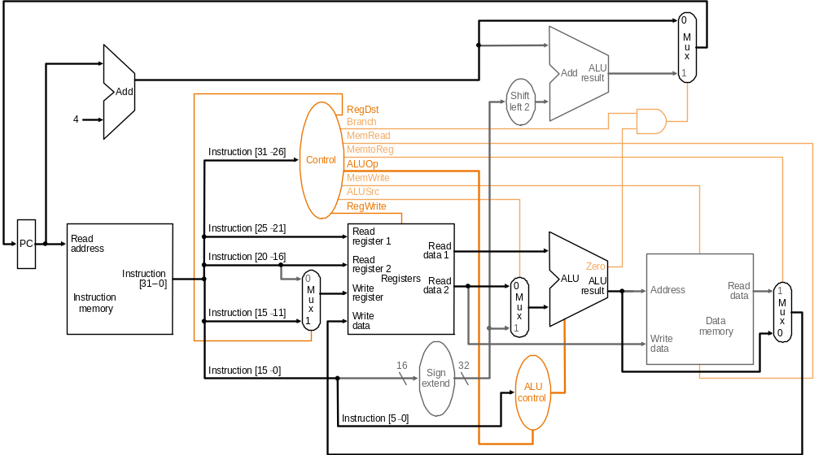
R-type Instruction: Step 4 add $t1, $t2, $t3 (active = bold)
Write result to register

Slide 71
Load Instruction Steps lw $t1, offset($t2)
Fetch instruction and increment PC
Read base register from the register file: the base register ($t2) is given by bits 25-21 of the instruction
ALU computes sum of value read from the register file and the sign-extended lower 16 bits (offset) of the instruction
The sum from the ALU is used as the address for the data memory
The data from the memory unit is written into the register file: the destination register ($t1) is given by bits 20-16 of the instruction

Slide 72
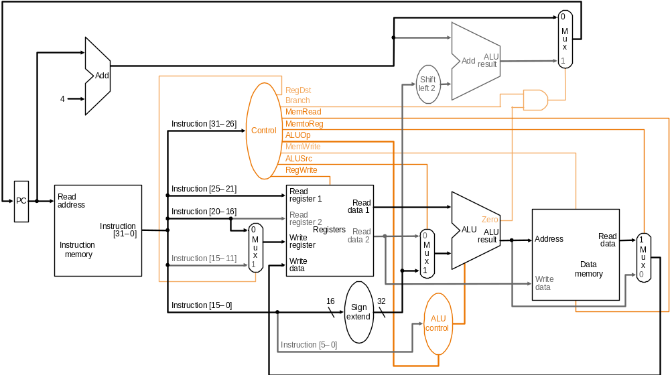
Load Instruction lw $t1, offset($t2)

Slide 73
Branch Instruction Steps beq $t1, $t2, offset
Fetch instruction and increment PC
Read two register ($t1 and $t2) from the register file
ALU performs a subtract on the data values from the register file; the value of PC+4 is added to the sign-extended lower 16 bits (offset) of the instruction shifted left by two to give the branch target address
The Zero result from the ALU is used to decide which adder result (from step 1 or 3) to store in the PC

Slide 74
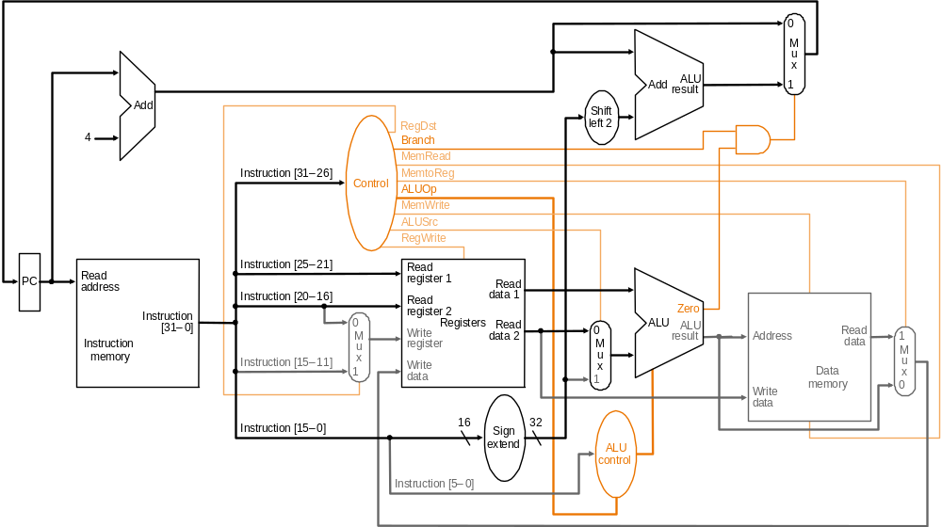
Branch Instruction beq $t1, $t2, offset

Slide 75
ALU Control
Plan to control ALU:
Main control sends a 2-bit ALUOp control field to the ALU control. Based on ALUOp and funct field of instruction
  The ALU control generates the 3-bit ALU control field
  ALU control Func-
field tion
000 and
001 or
010 add
110 sub
111 slt

Slide 76
ALU Control
Plan to control ALU: main control sends a 2-bit ALUOp control field to the ALU control. Based on ALUOp and funct field of instruction the ALU control generates the 3-bit ALU control field
  ALU control Func-
field tion
000 and
001 or
010 add
110 sub
111 slt
ALU must perform
  add for load/stores (ALUOp 00)
  sub for branches (ALUOp 01)
  one of and, or, add, sub, slt for R-type instructions, depending on the instruction’s 6-bit funct field (ALUOp 10)
Recall from ALU Design
2
ALUOp
3
Main
Control
ALU
Control
To
ALU
ALU
control
input
6
Instruction
funct field
ALUOp generation
by main control

Slide 77
Setting ALU Control Bits
Instruction AluOp Instruction Funct Field Desired ALU control
opcode operation ALU action input
LW 00 load word xxxxxx add 010
SW 00 store word xxxxxx add 010
Branch eq 01 branch eq xxxxxx subtract 110
R-type 10 add 100000 add 010
R-type 10 subtract 100010 subtract 110
R-type 10 AND 100100 and 000
R-type 10 OR 100101 or 001
R-type 10 set on less 101010 set on less 111
ALUOp
Funct field
Operation
ALUOp1
ALUOp0
F5
F4
F3
F2
F1
F0
0
0
X
X
X
X
X
X
010
0
1
X
X
X
X
X
X
110
1
X
X
X
0
0
0
0
010
1
X
X
X
0
0
1
0
110
1
X
X
X
0
1
0
0
000
1
X
X
X
0
1
0
1
001
1
X
X
X
1
0
1
0
111
Truth table for ALU control bits

Slide 78
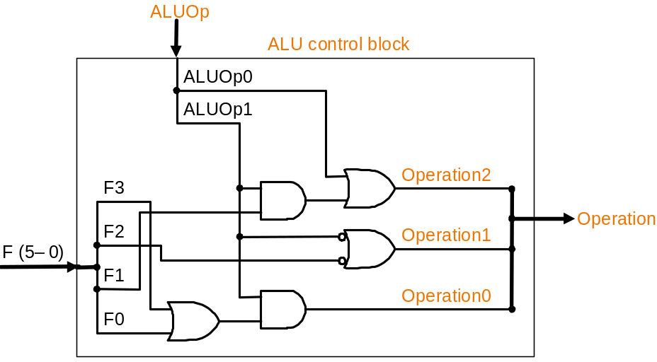
Implementation: ALU Control Block
ALUOp
Funct field
Operation
ALUOp1
ALUOp0
F5
F4
F3
F2
F1
F0
0
0
X
X
X
X
X
X
010
0
1
X
X
X
X
X
X
110
1
X
X
X
0
0
0
0
010
1
X
X
X
0
0
1
0
110
1
X
X
X
0
1
0
0
000
1
X
X
X
0
1
0
1
001
1
X
X
X
1
0
1
0
111
Truth table for ALU control bits
ALU control logic

Slide 79
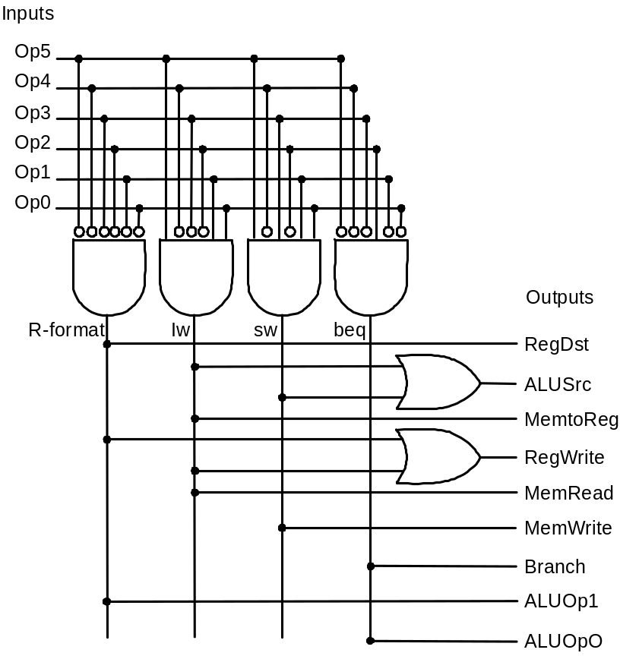
Implementation: Main Control Block
Signal R- lw sw beq
name format
Op5 0 1 1 0
Op4 0 0 0 0
Op3 0 0 1 0
Op2 0 0 0 1
Op1 0 1 1 0
Op0 0 1 1 0
RegDst 1 0 x x
ALUSrc 0 1 1 0
MemtoReg 0 1 x x
RegWrite 1 1 0 0
MemRead 0 1 0 0
MemWrite 0 0 1 0
Branch 0 0 0 1
ALUOp1 1 0 0 0
ALUOP2 0 0 0 1
Inputs
Outputs
Main control PLA (programmable
logic array): principle underlying
PLAs is that any logical expression
can be written as a sum-of-products
Truth table for main control signals

Slide 80
Logi Sim
All components that we have discussed – and shall discuss – can be fabricated using Logi Sim

Slide 81
Single-cycle Implementation Notes
The steps are not really distinct as each instruction completes in exactly one clock cycle – they simply indicate the sequence of data flowing through the datapath
The operation of the datapath during a cycle is purely combinational – nothing is stored during a clock cycle
Therefore, the machine is stable in a particular state at the start of a cycle and reaches a new stable state only at the end of the cycle

Slide 82
Single-Cycle Design Problems
Assuming fixed-period clock every instruction datapath uses one clock cycle implies:
  CPI = 1
  cycle time determined by length of the longest instruction path (load)
    but several instructions could run in a shorter clock cycle: waste of time when having more complicated instructions like floating point!
  resources used more than once in the same cycle need to be duplicated
    waste of hardware and chip area

Slide 83
Example: Fixed-period clock vs. variable-period clock in a single-cycle implementation
Consider a machine with an additional floating point unit. Assume functional unit delays as follows
  memory: 2 ns., ALU and adders: 2 ns., FPU add: 8 ns., FPU multiply: 16 ns., register file access (read or write): 1 ns.
  multiplexors, control unit, PC accesses, sign extension, wires: no delay
Assume instruction mix as follows
  all loads take same time and comprise 31%
  all stores take same time and comprise 21%
  R-format instructions comprise 27%
  branches comprise 5%
  jumps comprise 2%
  FP adds and subtracts take the same time and totally comprise 7%
  FP multiplys and divides take the same time and totally comprise 7%
Compare the performance of (a) a single-cycle implementation using a fixed-period clock with (b) one using a variable-period clock where each instruction executes in one clock cycle that is only as long as it needs to be.

Slide 84
Example (Cont.)
Functional unit delays as follows memory: 2 ns., ALU and adders: 2 ns., FPU add: 8 ns., FPU multiply: 16 ns., register file access (read or write): 1 ns.
  multiplexors, control unit, PC accesses, sign extension, wires: no delay
Instruction Instr. Register ALU Data Register FPU FPU
class mem. read oper. mem. write add/ mul/
sub div
Load word 2 1 2 2 1
Store word 2 1 2 2
R-format 2 1 2 0 1
Branch 2 1 2
Jump 2
FP mul/div 2 1 1 16
FP add/sub 2 1 1 8

Slide 85
Solution
Instruction Instr. Register ALU Data Register FPU FPU Total
class mem. read oper. mem. write add/ mul/ time
sub div ns.
Load word 2 1 2 2 1 8
Store word 2 1 2 2 7
R-format 2 1 2 0 1 6
Branch 2 1 2 5
Jump 2 2
FP mul/div 2 1 1 16 20
FP add/sub 2 1 1 8 12
Clock period for fixed-period clock
= longest instruction time = 20 ns.
Average clock period for variable-period clock
= 8 × 31% + 7 × 21% + 6 × 27% + 5 × 5% + 2 × 2% + 20 × 7% + 12 × 7%
= 7.0 ns.
Therefore, performance_{var-period} /performance_{fixed-period} = 20/7 = 2.9

Slide 86
Fixing the problem with single-cycle designs
One solution:
  a variable-period clock with different cycle times for each instruction class
    unfeasible, as implementing a variable-speed clock is technically difficult
Another solution:
  use a smaller cycle time…
  …have different instructions take different numbers of cycles
  by breaking instructions into steps and fitting each step into one cycle
  feasible: multicyle approach!

Slide 87
Next
Multi Cycle

Slide 88
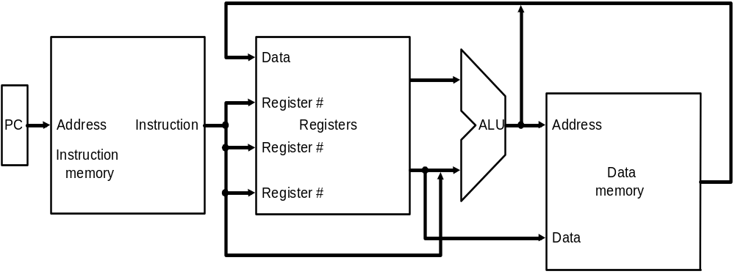
Implementing MIPS: the Fetch/Execute Cycle
High-level abstract view of fetch/execute implementation
  use the program counter (PC) to read instruction address
  fetch the instruction from memory and increment PC
  use fields of the instruction to select registers to read
  execute depending on the instruction
  repeat…

